Slide 1


Slide 2

ONLINE TAX MANAGEMENT SYSTEM
Supervisor: Mam Umra Naeem

Slide 3
Group Member Introduction:
Group ID : S2402D44F4
VU ID : BC220407915 (Sana Rasheed)

Slide 4
INTRODUCTION OF PROJECT
1. The Online Tax Management System is a web-based platform designed to automate and simplify the tax filing and payment process for both taxpayers and tax authorities.
2. It offers a user-friendly interface where taxpayers can easily register, file taxes, upload necessary documents, and make secure payments.
3. For tax authorities, the system provides tools for managing taxpayer data, verifying documents, setting tax rates, and generating detailed reports.
4. The system aims to improve efficiency, reduce errors, enhance compliance, and promote transparency in tax management, benefiting both taxpayers and authorities.

Slide 5
Functional Requirements:
User Registration:
Users can be admin/tax authority and tax payers.
Both admin and tax payers should be able to create and update their accounts.
Tax Data Entry and Management:
Users should be able to input and update their tax-related information.
There should be different interactive forms for different tax categories (income tax, property tax, sales tax, etc.).
Document Management
Document Upload: Taxpayers should be able to upload necessary documents for tax filing.
Document Verification: Automated verification of uploaded documents for accuracy.
Document Retrieval: Easy retrieval of past tax documents for reference.
4. Automated Tax Calculation:
System should calculate taxes based on tax payer’s inputs.
Generation of tax reports, summaries, and statements.
5. Payment Module
The system should allow Secure payment for tax payments.
There should be multiple payment methods (credit/debit card, bank transfer, etc.).
Reporting and Analytics
Tax Reports: Generation of tax reports for tax payers and authorities.
Notifications and Alerts
Automated Alerts: System should send reminders for tax deadlines and updates.
Custom Notifications: Admin should set up custom alerts for specific tax events.
Administrative Functions
Tax Rate Management: Admin will create and update tax rates and regulations.
Tax Payer Account Management: Admin will manage taxpayer accounts.

Slide 6
Non Functional Requirements:
Security: The system must ensure secure user authentication, data storage, and payment processing to protect sensitive tax information.
Usability: The platform should be user-friendly, with an intuitive interface for both taxpayers and tax authorities.
Scalability: The system should be able to handle increasing user data and tax transactions as the user base grows.
Performance: The application should provide quick response times for all transactions, including document uploads, tax calculations, and payment processing

Slide 7
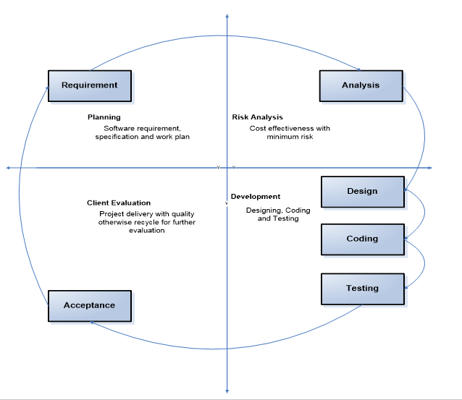
VU Process Model Diagram

Slide 8
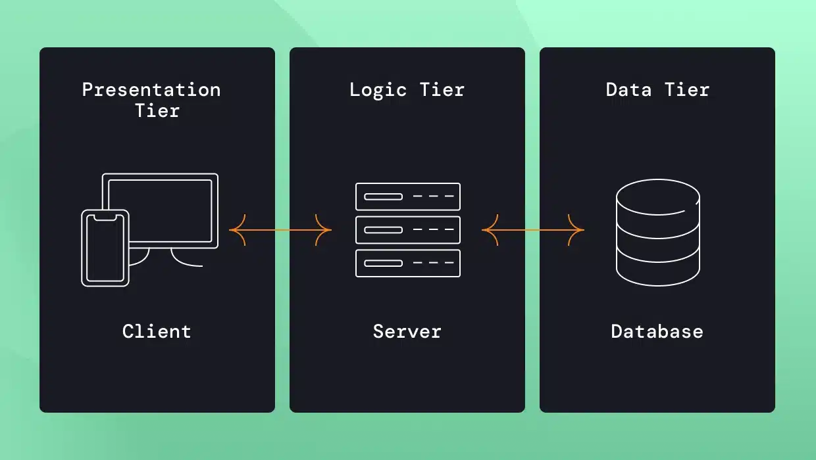
Architecture Diagram

Slide 9
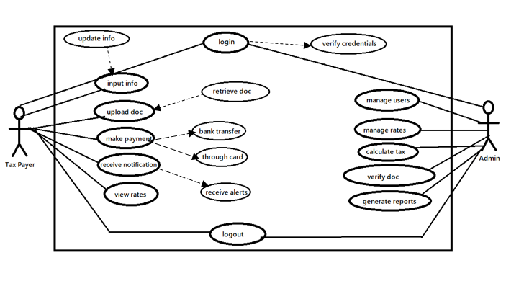
USE CASE DIAGRAM

Slide 10
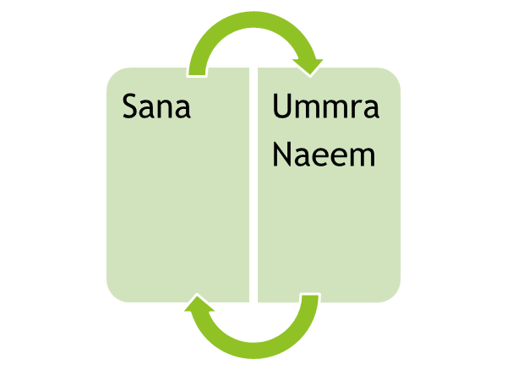
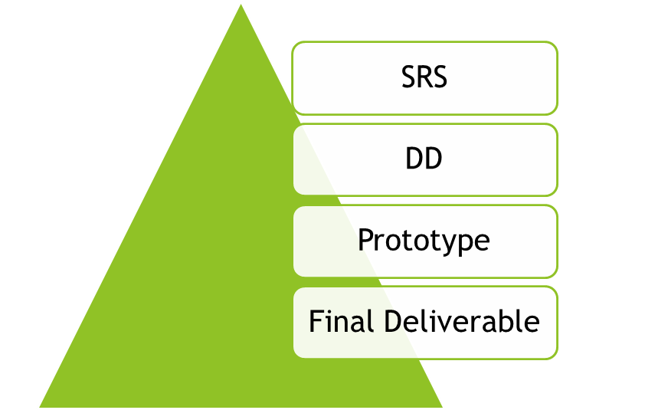
Team Diagram

Slide 11
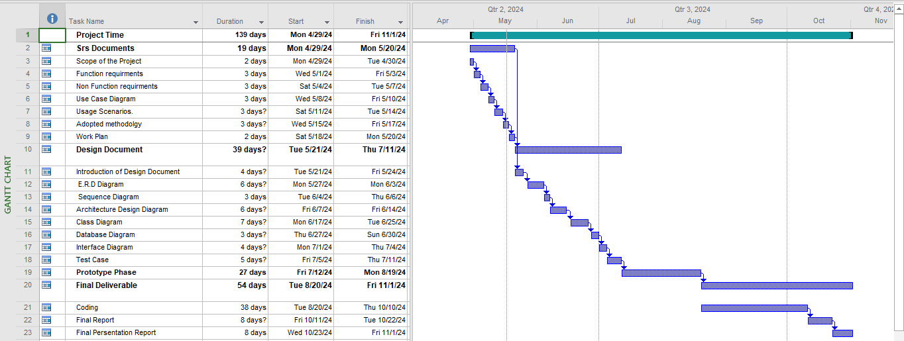
Project Schedule

Slide 12
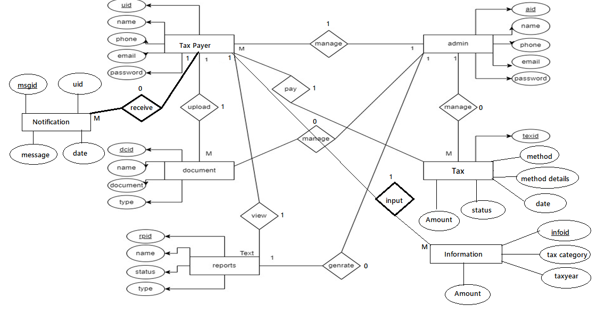
Entity-Relationship Diagram

Slide 13
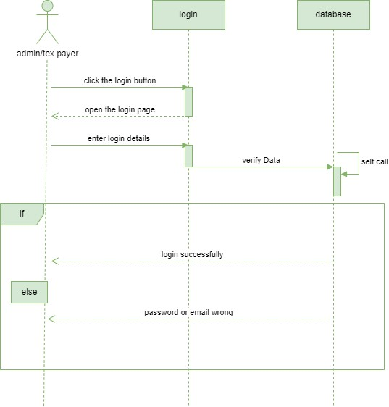
Sequence Diagrams(login)

Slide 14
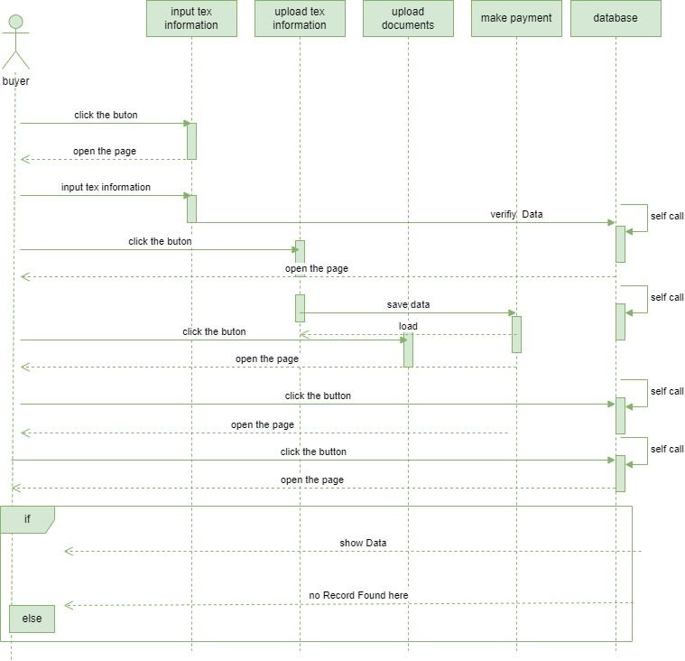
Sequence Diagrams(User Dashboard)

Slide 15
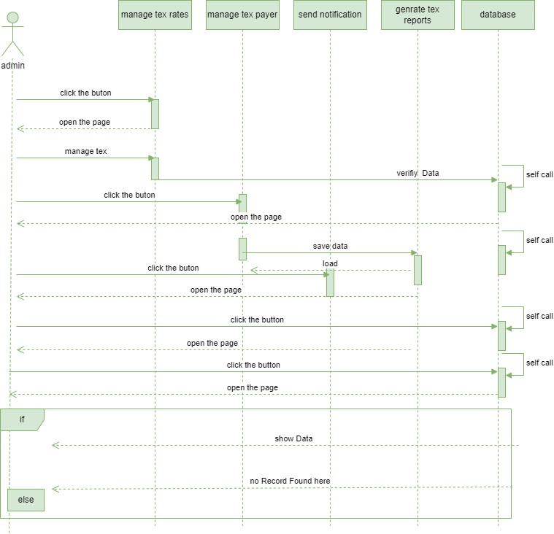
Sequence Diagrams(Admin Dashboard)

Slide 16
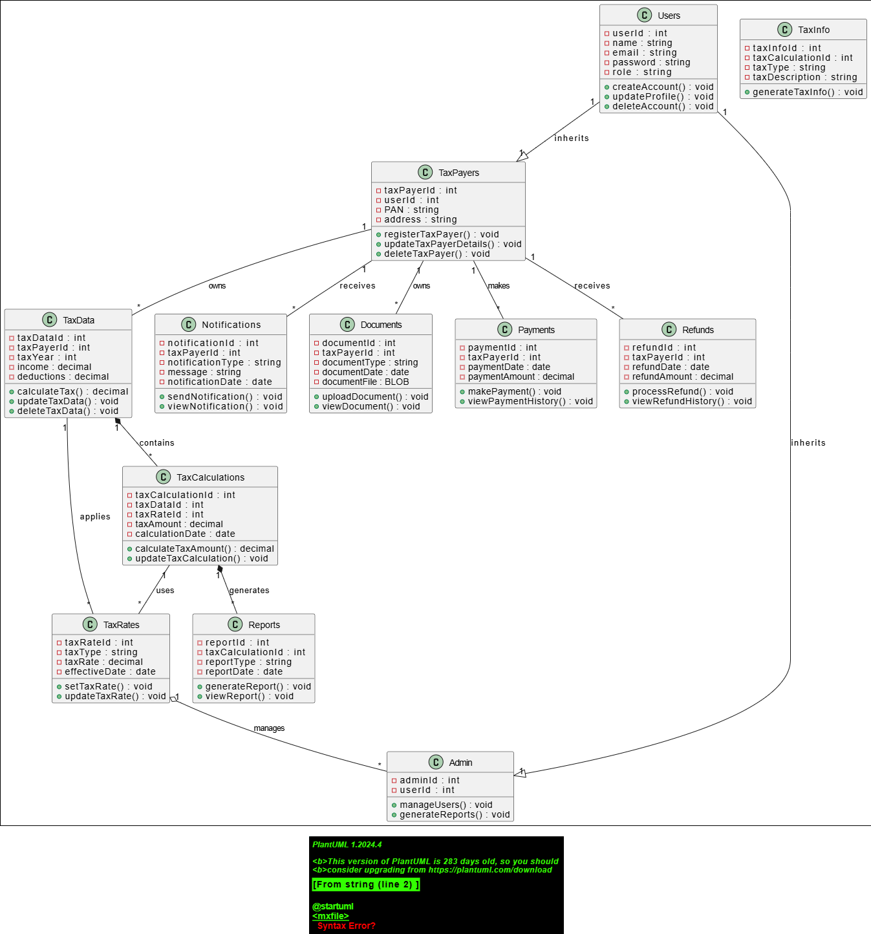
Logical Model/Class Diagram

Slide 17
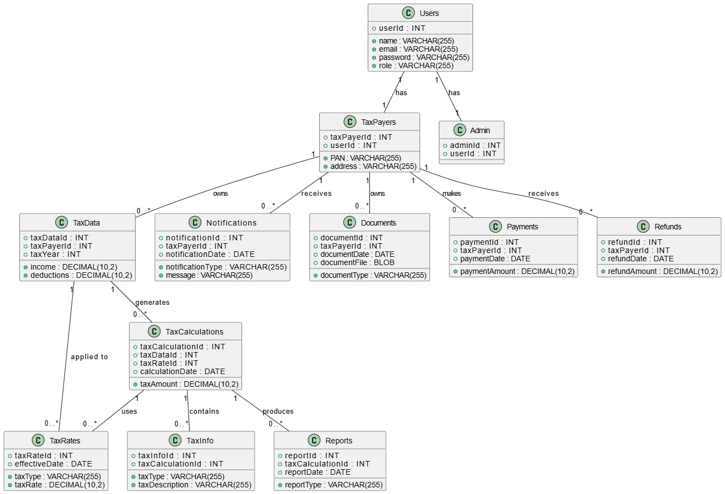
Database Diagram

Slide 18
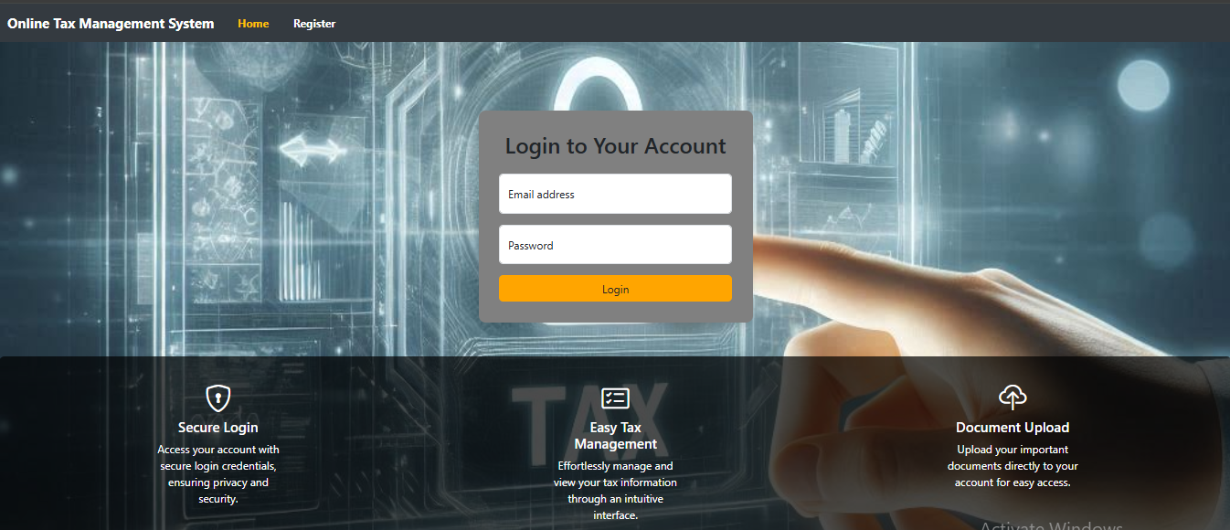
User Interfaces

Slide 19
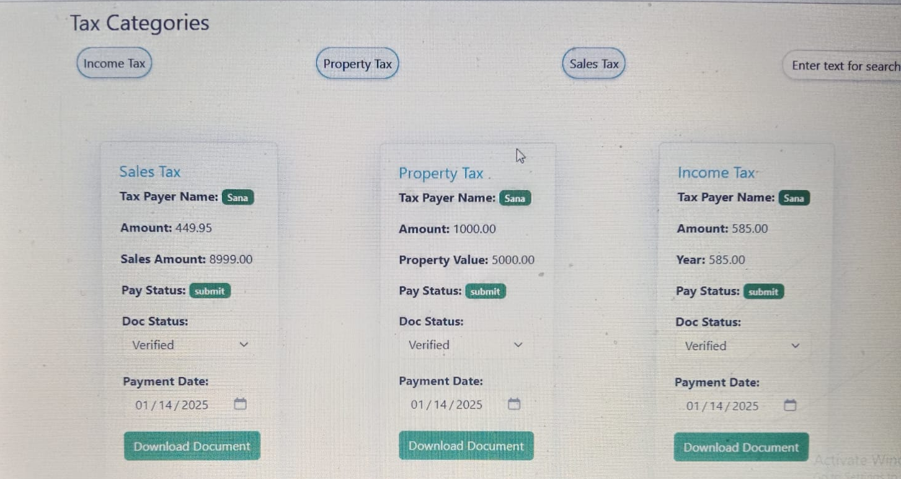
User Interfaces

Slide 20
Tools:
HTML, PHP, MYSQL, CSS
Software:
Editor: Vs code editor
Server: XAMPP Server

Slide 21



